Slide 1

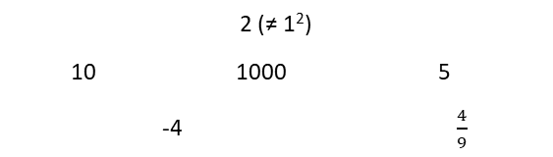
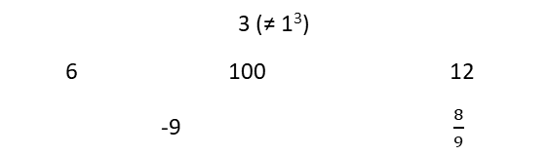
Subtopic N3.23 – Squares and Cubes
LEARNING OUTCOME: To understand square and cube numbers
Objectives:
To be able to recall the square numbers up to 15 squared
To be able to recall the cube numbers up to 10 cubed.
Keywords:
- Square
- Cube
Introduction:
Squares numbers and and cube numbers are ways of multiplying a number by itself a certain number of
times, creating what we call powers. When you square a number, you multiply it by itself. Cubing a
number means multiplying it by itself and then multiplying by itself again. Knowing how to work with
squares and cubes is an important skill, as it forms the foundation for understanding powers,
exponents and roots.
Definition
Characteristics
The process of creating a square number is called “squaring” and is shown using an index of 2
An integer multiplied by itself makes a square number
Examples
Square number
Non - Examples
4 (= 2²) 9 (= 3²) 100 (= 10²)
484 (=22²) 1 (= 1²) 10 000 (= 100²)
Definition
Characteristics
The process of creating a cube number is called “cubing” and is shown using an index of 3
An integer multiplied by itself and then itself again makes a cube number
3
Examples
Cube number
Non - Examples
8 (= 2³) 27 (= 3³) 1000 (= 10³)
10 648 (=22³) 1 (= 1³) 1 000 000 (= 100³)
Index form and language
Example 1 - I do…
Power | Base | Index | Index Form | Say | Calculation | Value
1st |  |  |  | Five
2nd |  |  |  | Five Squared |  | 25
3rd |  |  |  | Five cubed |  | 125

Slide 2
Example 2 – We do…
Power | Base | Index | Index Form | Say | Calculation | Value
1st |  |  |  | Two
2nd |  |  |  | Two Squared |  | 4
3rd |  |  |  | Two Cubed
Example 3 – You do…
Power | Base | Index | Index Form | Say | Calculation | Value
1st |  |  |  | Four
2nd |  |  |  | Four squared
3rd |  |  |  | Four cubed
Independent Practice
1. Fill in the blanks
a)
Power | Base | Index | Index Form | Say | Calculation | Value
1st |  |  |  | Three
2nd |  |  |  | Three squared
3rd |  |  |  | Three cubed
b)
Power | Base | Index | Index Form | Say | Calculation | Value
1st |  |  |  | One
2nd |  |  |  | One squared
3rd |  |  |  | One cubed

Slide 3




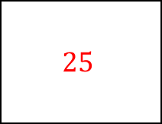
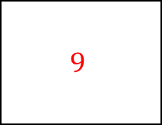
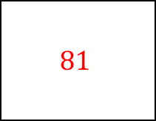
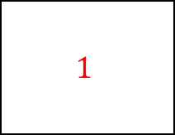




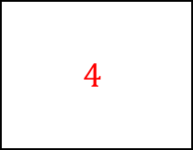
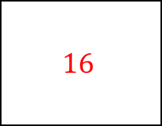
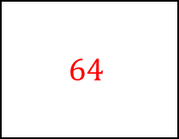
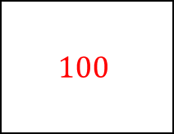
c)
Power | Base | Index | Index Form | Say | Calculation | Value
1st |  |  |  | Six
2nd |  |  |  | Six squared
3rd |  |  |  | Six cubed
d)
Power | Base | Index | Index Form | Say | Calculation | Value
1st |  |  |  | Eight
2nd |  |  |  | Eight squared
3rd |  |  |  | Eight cubed
To be able to recall the square numbers up to 15 squared
Example 4 - I do…
Example 5 – We do…
Example 6 – You do…
Steps
Identify the base. This is the number we are multiplying.
Identify the index. This is how many times we multiply the base number by itself.
Independent Practice
2. Without using a calculator, calculate the value of:

Slide 4








To be able to recall the cube numbers up to 10 cubed
Example 7 - I do…
Example 8 – We do…
Example 9 – You do…
Steps
Identify the base. This is the number we are multiplying.
Identify the index. This is how many times we multiply the base number by itself.
Independent Practice
3. Calculate the value of:
1 8 27 64
125 216 343 1000
Skills Check

